Slide 1
Table tense -Ping pong game
It s a game in which two players (you and the computer) hit a little, light ball back and forth across a table using a small paddle. A point is scored when a player fails to return the ball to the other player .

Slide 2
Technology
HTML 5
CSS3
JavaScript
Simple AI
VSC
GITHUB

Slide 3
How to play!
The user paddle is always in the left
You can control the paddle by mouse and if the pointer was out the canvas the player will lose the control .
Every time the ball hit the paddle the ball speed will increase by 0.1

Slide 4
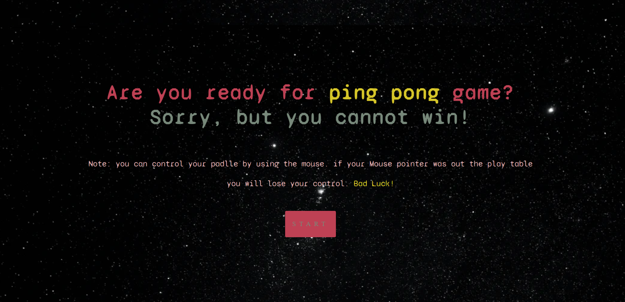

Slide 5
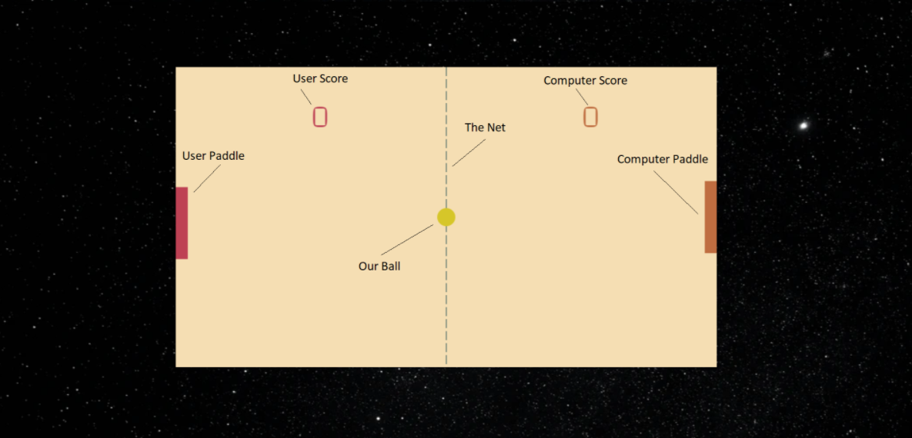

Slide 6
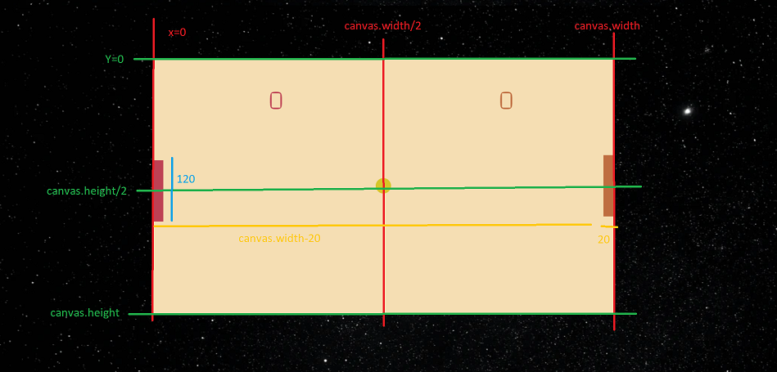
Width/4
3*(Width/4)

Slide 7
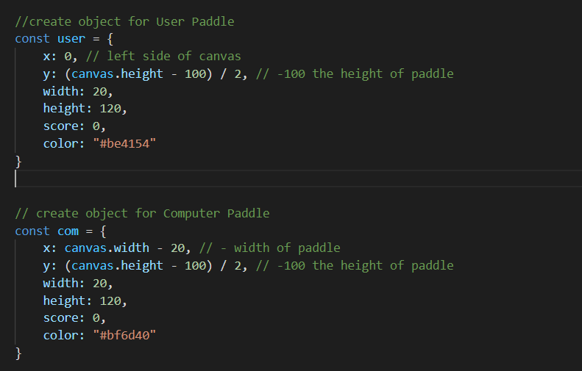

Slide 8
How the computer plays -Simple AI
//AI to control the computer paddle
let comLevel = 0.1;
com.y += (ball.y - (com.y + com.height / 2)) * comLevel;
Increment the computer paddle by …
The center of
the com paddle
Y position for the ball

Slide 9
Favorite function
//collision function
function collision(b, p) {//b for ball , p for player
b.top = b.y - b.radius;
b.bottom = b.y + b.radius;
b.left = b.x - b.radius;
b.right = b.x + b.radius;
p.top = p.y;
p.bottom = p.y + p.height;
p.left = p.x;
p.right = p.x + p.width;
//test if there is collision or not
return p.left < b.right && p.top < b.bottom && p.right > b.left && p.bottom > b.top; } //return true? there is a collision

Slide 10
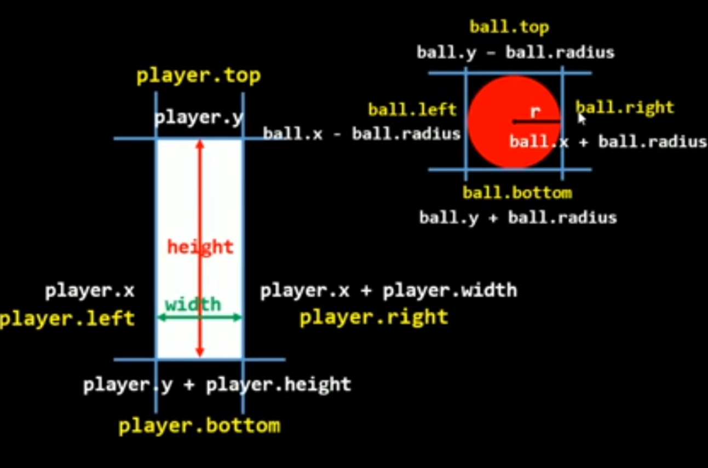
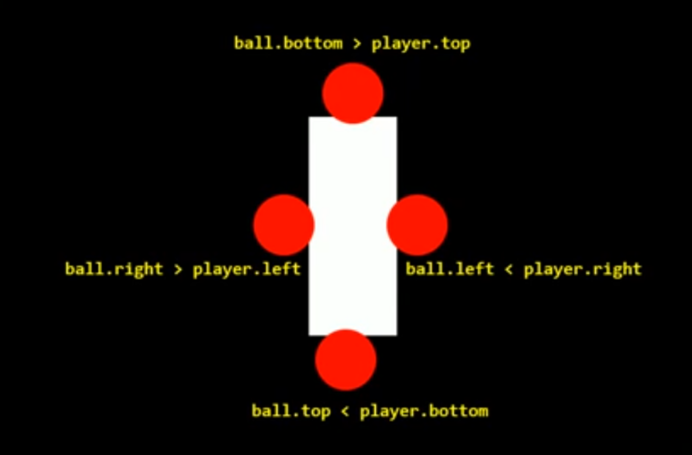

Slide 11
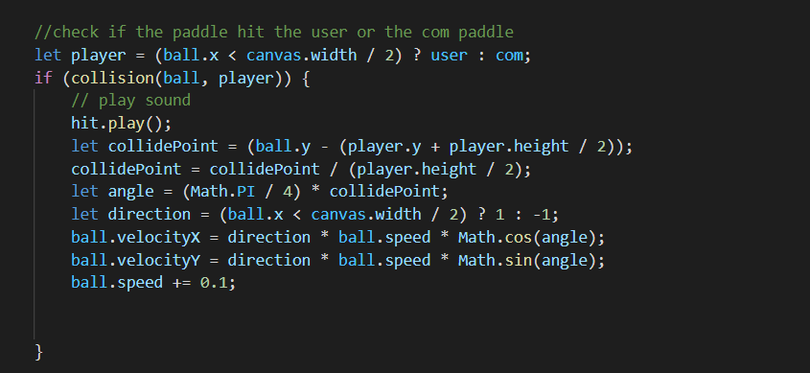
If it 0

Slide 12
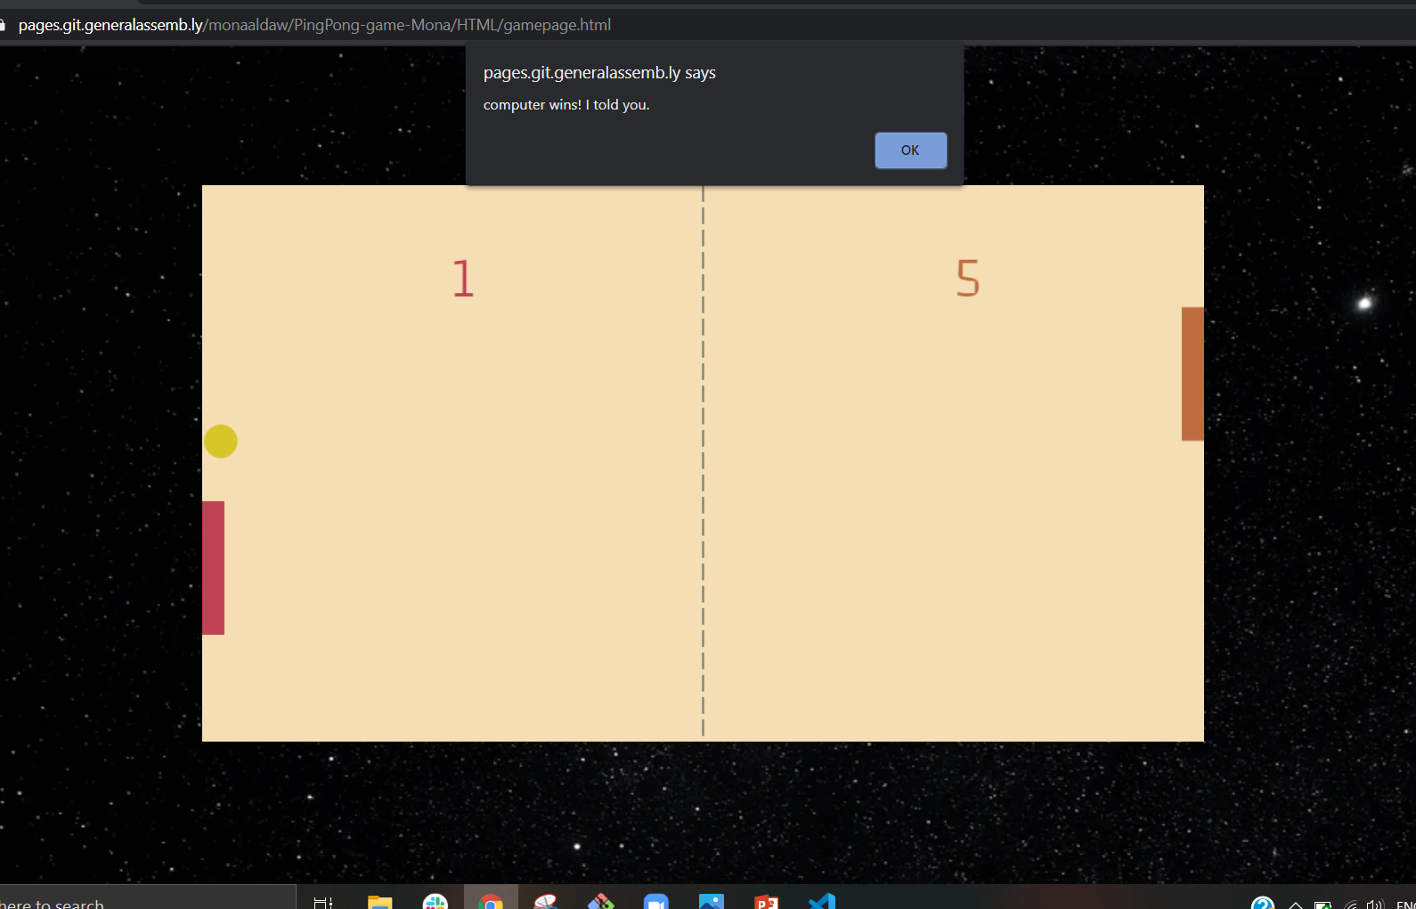
The winner
the one who score 5 point (you or the computer) before the other will win! be calm there no limit time. Although I doubt you are able to win!

Slide 13
Future Features
Difficulty - Easy | Medium | Hard
Player Controller - Swipe | Button
Player Position - Left | Right
Game Point - 3 to 15
Player Name - Your Name
Result Screen
Settings Panel

Slide 14
GitHub link :
https://pages.git.generalassemb.ly/monaaldaw/PingPong-game-Mona/
Repository:
https://git.generalassemb.ly/monaaldaw/PingPong-game-Mona

Slide 16
Questions Time ,Feel free to ask anything.

